Slide 1
File and Stream I/o

Slide 2
Intoduction
File and stream I/O (input/output) refers to the transfer of data either to
or from a storage medium.
In the .NET Framework, the System.IO namespaces contain types that
enable reading and writing, both synchronously and asynchronously,
on data streams and files.

Slide 3
IO Namespace and its Classes
IO namespace includes classes that facilitate
reading and writing of data to data streams and files
Classes of IO namespace used for handling files are:
BinaryReader TextWriter
BinaryWriter Directory
Stream File
TextReader FileSystemInfo

Slide 4
BinaryReader and BinaryWriter Class
Used for reading binary data to file
Methods supported are : BinaryReader
Used for writing binary data to file
Methods supported are : BinaryWriter
Methods | Description
Close() | Used to close the current stream from which data is being read
Read() | Employed to read characters from the specified stream
Methods | Description
Close() | Used to close the current stream from which data is being Written to file or directory
Write() | Employed to Write characters from the specified stream

Slide 5
Example:
using System;
using System.IO;
class BinaryDemo
{
private const string fname = "Binary.data";
public static void Main(String[] args)
{
//check if file already exists
If (File.Exists(fname))
{
Console.WriteLine("{0} already exists!", fname);
return;
}
// if not existing then create a new empty data file.
FileStream fs = new FileStream(fname,
FileMode.CreateNew);

Slide 6
// Create the writer for data.
BinaryWriter w = new BinaryWriter(fs);
for (int i = 0; i < 11; i++)
{
w.Write( (int) i);
}
Console.WriteLine ("Data has been written to the file!");
w.Close();
fs.Close();
// Create the reader for data.
fs = new FileStream(fname, FileMode.Open, FileAccess.Read);
BinaryReader r = new BinaryReader(fs);
Console.WriteLine("The data file contents are:");
// Read data from the data file.
for (int i = 0; i < 11; i++) Output:
{
Console.WriteLine(r.ReadInt32());
}
w.Close();
}
}

Slide 7
Stream Class
It is an abstract class from which different standard methods to transfer bytes(read,write,etc) to the source.
Classes that need to read/write bytes from a particular source must implement the Stream class
Some of its derived classes are:
▪ MemoryStream
▪ BufferedStream
▪ FileStream
▪ NetworkStream
▪ CryptoStream
▪ PipeStream
▪ IsolatedStorage FileStream

Slide 8
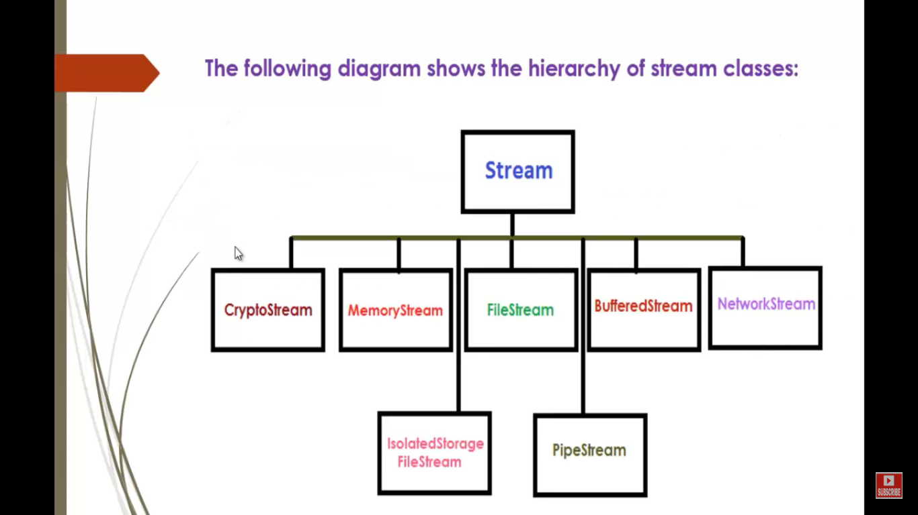

Slide 9
Here are some commonly used stream classes:
FileStream – for reading and writing to a file.
IsolatedStorageFileStream – for reading and writing to a file in isolated storage.
MemoryStream – for reading and writing to memory as the backing store.
BufferedStream – for improving performance of read and write operations.
NetworkStream – for reading and writing over network sockets.
PipeStream – for reading and writing over anonymous and named pipes.
CryptoStream – for linking data streams to cryptographic transformations.

Slide 10
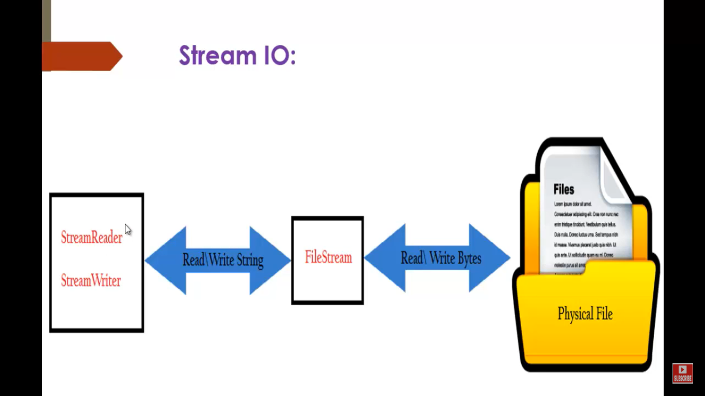

Slide 11
FileStream Class
This class is used to perform read and write operations on files
■ Read() and Write() methods are applied for synchronous read and write operations
■ BeginRead() and BeginWrite() methods are used for asynchronous read and write operations
■ The default mode in the FileStream class is synchronous read/write operations

Slide 12
Example
using System;
using System.IO;
using System.Text;
class FileStreamDemo
{
public static void Main()
{
Console.WriteLine ("Enter the text file name");
string fname = Console.ReadLine();
StreamReader sr = new StreamReader(fname) ;
string line;
while ((line = sr.ReadLine()) != null)
{
Console.WriteLine (line);
}
Console.WriteLine("");

Slide 13
sr.Close();
FileStream filestr = new FileStream(fname,
FileMode.Append, FileAccess.Write, FileShare.Write);
filestr.Close();
StreamWriter sw = new StreamWriter (fname, true,
Encoding.ASCII);
string NextLine = "This is the appended line.";
sw.Write(NextLine);
sw.Close();
Console.WriteLine ("Appended one line into the file");
}
}
Output:

Slide 14
Directory and File Classes
The directory class contains static methods that help in handling directories and subdirectories
The static methods of this class can be called without an instance of a directory
The file class contains static methods that help in handling files
It also helps in the creation of FileStream class

Slide 15
Example
using System;
using System.IO;
class DirectoryDemo
{
static void Main(string[] args)
{
Directory.CreateDirectory ("Testdir");
File.Copy ("D:\\abc.txt", "Testdir\\abc.txt");
Console.WriteLine("File Content Copied");
}
}

Slide 16
FileInfo and DirectoryInfo
■ It is an abstract class from which the FileInfo and DirectoryInfo classes have been derived
■ The DirectoryInfo class contains methods that can be used to handle directories and subdirectories
■ The DirectoryInfo class exposes instance methods
■ The methods of DirectoryInfo class can be called only by an instance of the DirectoryInfo class
■ The FileInfo class contains methods that can be used to handle files

Slide 17
TextReader class
■ It is an abstract base class for the StreamReader and StringReader classes
■ These classes can be used to read a sequential series of characters
■ The StreamReader reads a character in a byte stream and converts it to the specified encoding
■ The StringReader class is used to read data from an input string

Slide 18
Example of StreamReader class
using System;
using System.IO;
public class TextDemo
{
static string ans="y";
public static void Main(String[] args)
{
Console.WriteLine("1. Read File ");
Console.WriteLine("2. Read String ");
Reading();
}
static void Reading()
{
try
{
if(ans=="y" || ans=="Y")
{

Slide 19
Console.Write ("Enter Your Choice [1/2]: ");
int choice=Convert.ToInt32(Console.ReadLine());
If (choice==1)
{
Console.WriteLine ("Enter the file name: ");
string Filename = Console.ReadLine();
if (!File.Exists(Filename))
{
Console.WriteLine("{0} does not exist!“ ,Filename);
return;
}
StreamReader sr = File.OpenText(Filename);
String input;
Console.WriteLine("The contents of the file are: \n"); while ((input= sr.ReadLine())!=null)
{
Console.WriteLine (input);
}
Console.WriteLine ("The end of the stream is reached.");
sr.Close();
Console.Write( "Do you want to continue [Y/N]:");
ans= Console.ReadLine();
Reading();
}

Slide 20
else if (choice==2) {
Console.Write ("Enter a string: ");
String str = Console.ReadLine();
char[] b = new char [str.Length];
StringReader sr = new StringReader (str);
sr.Read(b, 0, str.Length);
Console.WriteLine (b);
Console.Write ("Do you want to continue [Y/N]:");
ans= Console.ReadLine();
Reading(); Output:
}
Else {
Console.WriteLine ("Enter either 1 or 2 as your
choice");
}
}
}
catch(Exception e) {
Console.WriteLine (e.StackTrace);
Console.WriteLine (e.Message);
}
}
}

Slide 21
TextWriter class
It is an abstract base class for classes that can be used to write sequential characters
The StreamWriter and StringWriter classes are two of the derived classes of the TextWriter class
The StreamWriter writes characters to a stream in a specified encoding
The StringWriter class is used to write data to a string
Methods of StreamWriter class
▪ Write()
▪ WriteLine()

Slide 22
Example of StreamWriter class
using System;
using System.IO;
using System.Text;
public class Writer {
static string ans="y";
public static void Main(String[] args) {
Writing();
}
static void Writing() {
if (ans=="y" || ans=="Y") {
Console.Write ("Enter the file name: ");
string Filename = Console.ReadLine();

Slide 23
if (!File.Exists(Filename))
{
Console.WriteLine("{0} does not exist!",Filename);
return;
}
StreamWriter sr = File.AppendText(Filename);
Console.Write ("Enter a string to be written to the file: ");
String str = Console.ReadLine();
sr.WriteLine(str);
sr.Close();
Console.Write ("Do you want to continue [Y/N]: ");
ans= Console.ReadLine();
Writing();
}
}
}
Output:

Slide 24
Thank you

